Slide 1
SNOW INCIDENT FIELDS
SANKET RAUT

Slide 2
HOMEPAGE (ENTERPRISE PORTAL)
SERVICES
SNOW

Slide 3
INCIDENT MANAGEMENT PROCESS
TRIAGE
The triage team validates the ticket on basis of ticket type, priority and assigns to right application/person for further analysis of ticket.
IN PROGRESS
After acknowledging the ticket on the basis of ticket type, priority the issue raised through the ticket is tried to resolved.
WAITING FOR CUSTOMER
All the updates related to the issue are updated in ‘Customer Communication’ field. The communication is done via skype, mail and call. The next update field is updated to get back to the customer and resolve the issue.
WAITING FOR DEPENDENCY
If the issue is not resolved within allotted time as per the ticket type, a problem ticket is created with justified reason only.
RESOLVED
The status of the ticket is changed to resolved only when the root cause is identified and permanent resolution is given.

Slide 4
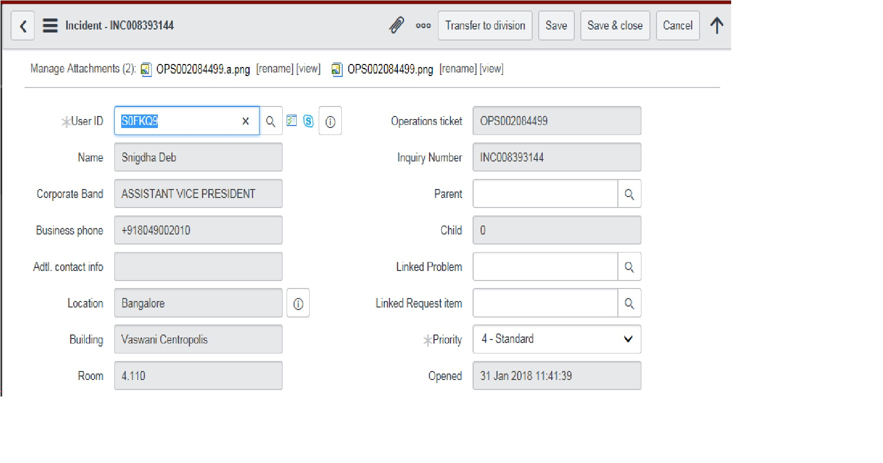
INCIDENT FIELDS

Slide 5
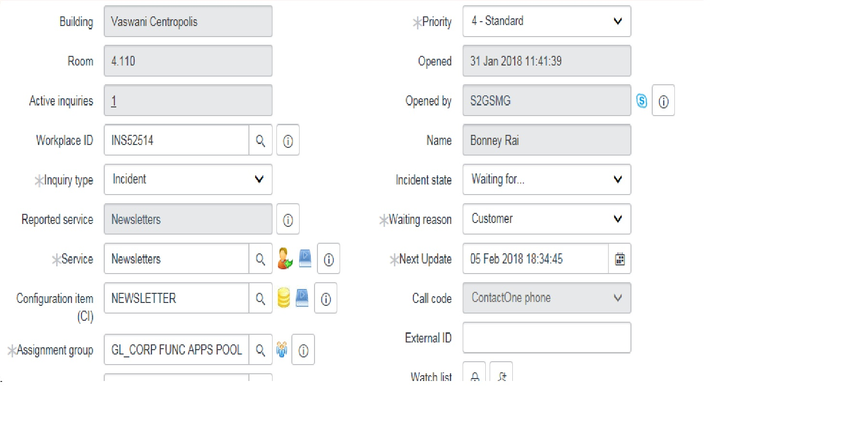
INCIDENT FIELDS

Slide 6
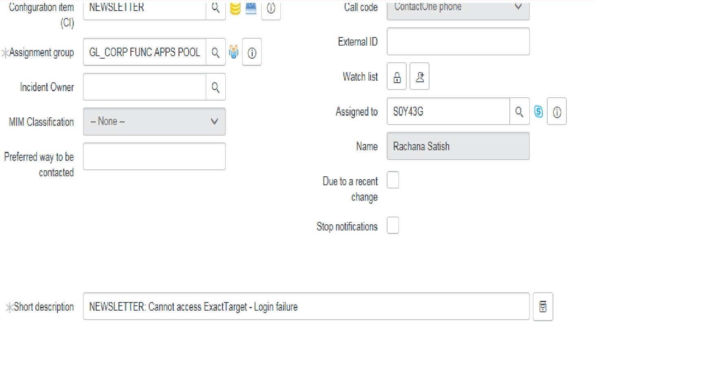
INCIDENT FIELDS

Slide 7
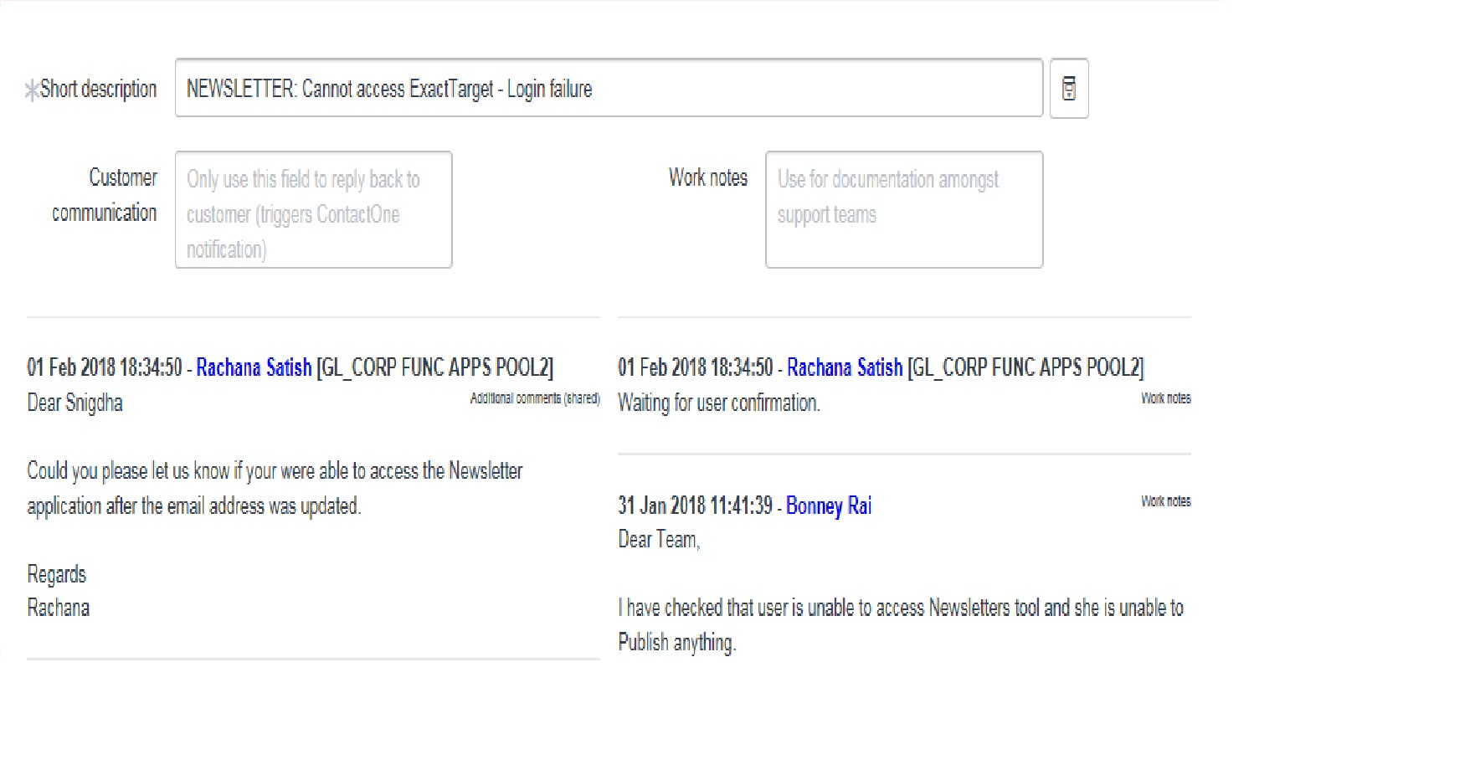
INCIDENT FIELDS

Slide 8
INCIDENT FIELDS
User ID: It is the user id of the customer who has raised the issue.
Name: Name of the customer.
Corporate Band: The designation of the requestor.
Business Phone: Work contact number.
Additional contact number: Alternate phone number if any.
Location: The location of the customer where he/she works.
Building: Name of the building is mentioned if any.
Room: Room number is given.
Active Inquiries: It is the number of tickets which requestor has raised and which are in opened state.
Workplace ID: It is the name of the computer on which the user works. (For example : CHR5XXXX)

Slide 9
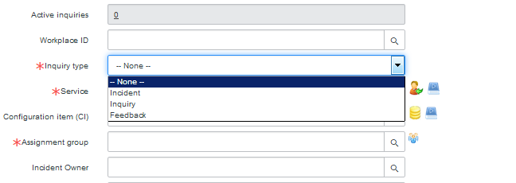
INCIDENT FIELDS
Inquiry type: These are of 4 types as mentioned below
Incident
Inquiry
Feedback

Slide 10
INCIDENT FIELDS
Service: It’s updated on updating configuration item.
Configuration item: It is nothing but the service to which application we provide. If not provided we can find it through customer communication.
Assignment group: The team to which the ticket is assigned.
Preferred way to be contacted: Email, skype, call.
Operations ticket: It is the ticket number which is mentioned in the mail.
Inquiry number: It is nothing but the incident ticket number.
Parent: If we get new ticket with the same issue, then one ticket is made parent and one child.
Child: Any changes made in the parent ticket will be reflected in the child ticket.
Linked problem: If the incident ticket is not resolved within the time allotted or there is no proper resolution, then one more ticket is created which is problem ticket. This problem ticket is attached to Incident by copying problem number and pasting in incident’s linked number.

Slide 11
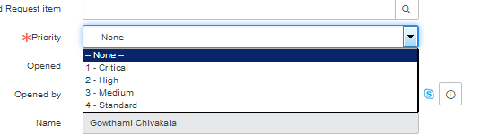
INCIDENT FIELDS
Priority: The priority of the ticket is mentioned in the mail itself. If it is not given then through customer communication it is updated.
Priority is of four types:
1 – Critical (15 mins)
2 – High (2 hours)
3 – Medium (2 hours)
4 – Standard (2 hours)

Slide 12
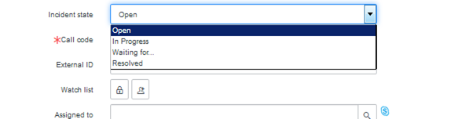
INCIDENT FIELDS
Opened: Day and time on which the ticket is opened.
Opened by: User ID of the person who has opened the ticket.
Name: Name of the user.
Incident state: Status of the ticket
Open
In progress
Waiting for
Resolved

Slide 13
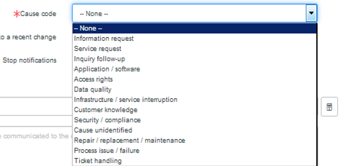
INCIDENT FIELDS
External Id: The CR number needs to be referenced in external ID for reference.
Watch list: Application managers are added in the watch list.
Assigned to: The user to whom ticket is assigned.
Name: Assigned user’s name.
Cause code: According to the issue, the cause code is mentioned.

Slide 14
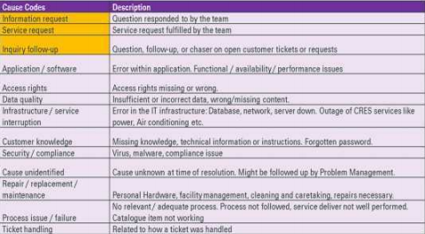
CAUSE CODE

Slide 15
INCIDENT FIELDS
Due to recent change: It is ticked when any new updates are made in the application which introduces changes in the behavior.
Stop notifications: It is available on all tickets. If checked customer communication is reduced.
Short description: The configuration item is mentioned as prefix and description is given about the issue.
Resolution text: When incident state is resolved, resolution text appears where in proper resolution is given regarding the issue.
Customer communication: The ticket updates are communicated with the requestor through this field. It has to be updated on each and every update.
Work notes: This field is for our and team’s reference. It is mandatory to fill this field.

